Slide 1
Band Instruments
5th Grade Band

Slide 2
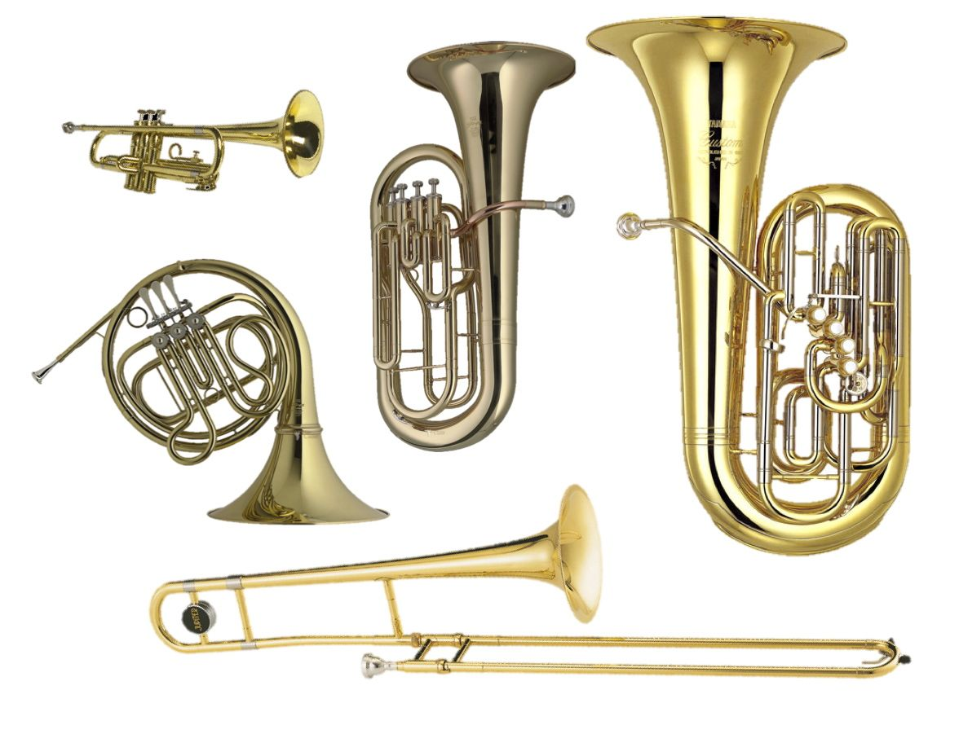
Brass
Made of metal
Has a cone or bowl shaped mouthpiece
Makes sound by “buzzing” into the mouthpiece
Includes Tuba, Baritone, Trombone, French Horn, and Trumpet
GoPro on Trombone: Star Wars - Imperial March - YouTube
Quaratine Quartet - Super Mario Brothers - YouTube
Fun Tuba Songs: Top 10 Epic Songs for Band Kids (NO Baby Shark!) – YouTube
Lewis Capaldi: Someone You Loved - French Horn Solo – YouTube
TOP 10 MOST POPULAR TRUMPET SONGS (with Sheet Music / Notes) - YouTube

Slide 3
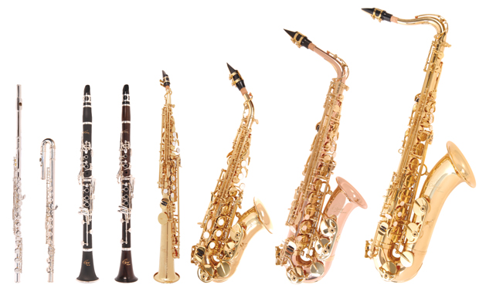
Woodwind
Made of wood, plastic, or metal
Have lots of keys
Make sound by a vibrating reed, or the splitting of air
Includes flute, clarinet, bass clarinet, alto saxophone, tenor saxophone, and baritone saxophone
Havana - Camila Cabello Flute Cover - YouTube
SHAKE IT OFF - S.WITH(에스윗) SAXOPHONE QUARTET – YouTube
You've Got a Friend in Me - Clarinet Quartet – YouTube

Slide 4
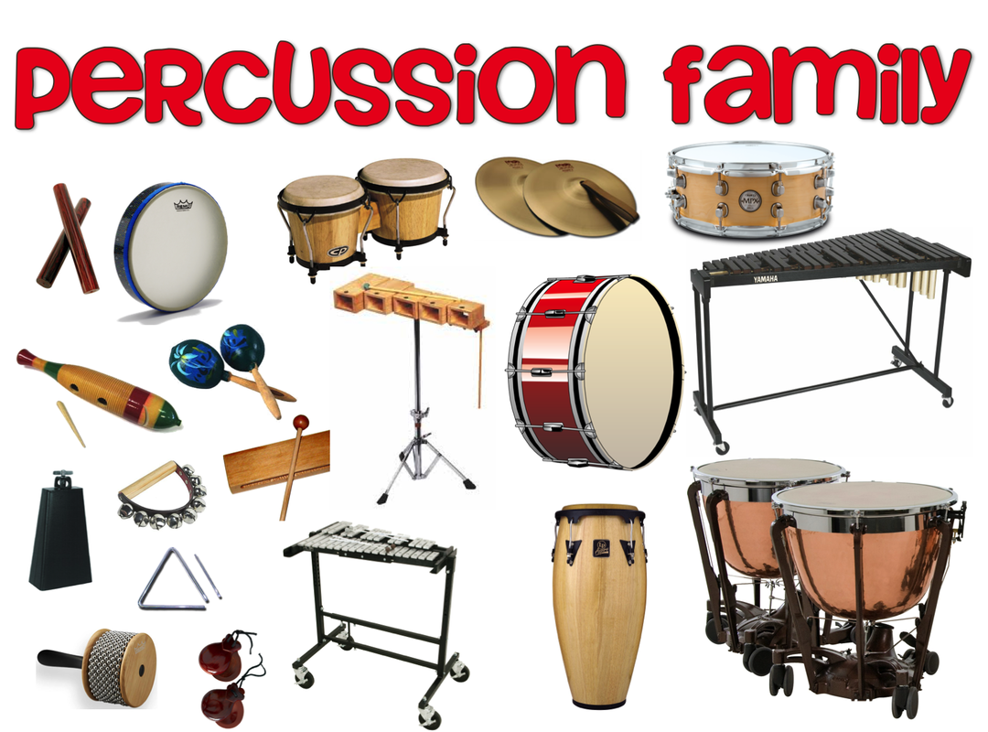
Percussion
Made of many things
Makes sound by hitting or scraping
Includes many instruments, including snare drum, bass drum, timpani, bells, xylophone, and many more!
https://www.youtube.com/watch?v=iySn1DnKPXM
https://www.youtube.com/watch?v=SYSxOj6W7IQ

Slide 5
Band Instruments
School Owned Instruments
Tuba, Baritone, French Horn, Tenor Saxophone, Baritone Saxophone, Bass Clarinet, Most Percussion instruments.
These may be rented for $30 per semester, or $60 per year
Other instruments can be purchased through Taylor Music in Aberdeen.
Monthly payment program

